Slide 1


Python Web apI - Restful
Todo Task List

Slide 2
Create a new app with out project
new webapp:
PS> pipenv shell
PS> python manage.py startapp task
Add new app to installed app. Also add the rest_framework 3rd party app:
INSTALLED_APPS = [
……, # Django default apps
# 3rd party app
‘rest_framework’, #new
# added app
'user’,
‘task’, #new
]

Slide 3
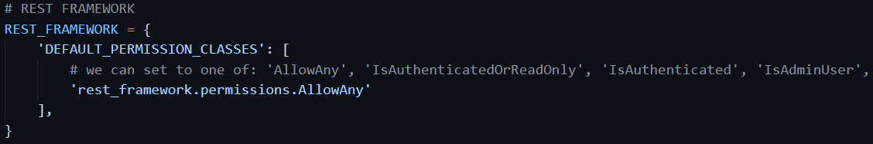
Overall project permissions in settings.py
Set permissions to AllowAny, so any user can use

Slide 4
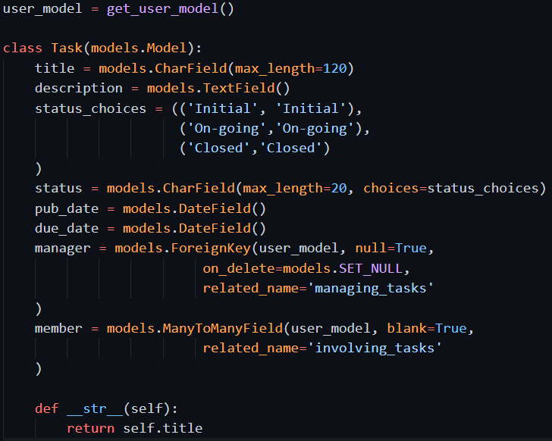
Create new model
new model:

Slide 5
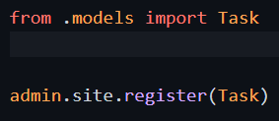
Register with admin
Register new model with admin
Migrate, and then run server and check with admin page

Slide 6
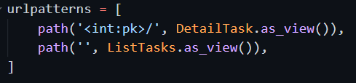


add url conf and view
url conf can use same way as normal django webapp
Define view using new rest_framework views

Slide 7
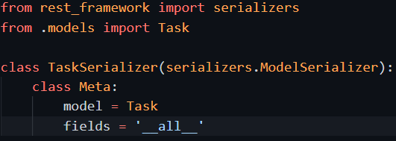
add Serializer
Rest API do not need present information/data in HTML. No need template.
Rest API need to send out data in JSON or XML format. Need add serializer to achieve this.
Create a serializer.py file and add following code:

Slide 8
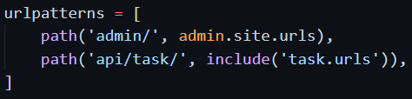
add task urls to project root urls

Slide 9
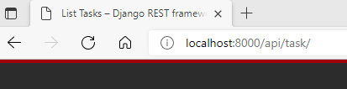
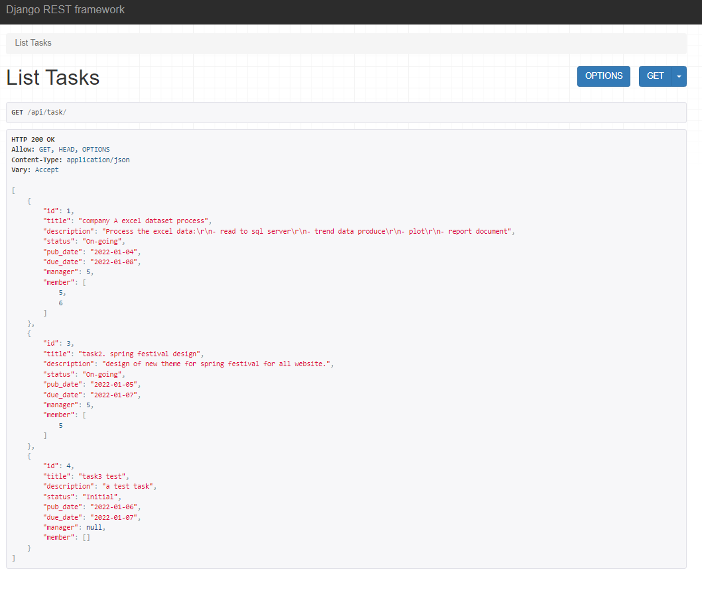
Rest framework has an web interface to view the data
You can create several tasks with admin
Then visit the api/task/ url, rest_framework gives back a form interface to be used.
The returned data also presented, in pretty JSON format.

Slide 10
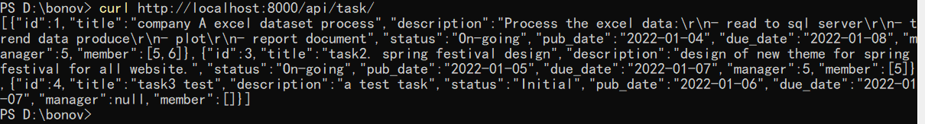
Use curl to see how other 3rd party actually using your API
If you use curl to get from endpoints, will return original json data

Slide 11
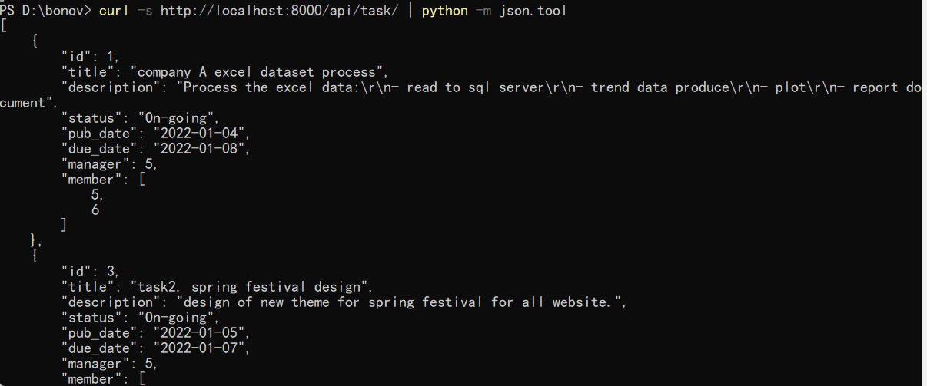
Use curl to see how other 3rd party actually using your API
You can use python json.tool to make the json data pretty and easy for view

Slide 12


More functionality: update, delete, create
The two view we created is to read the data. One for all list of data, one for a specific record of data.
CRUD (create, read, update, delete), need more functionality. With rest_framework, is easy to extend.

Slide 13
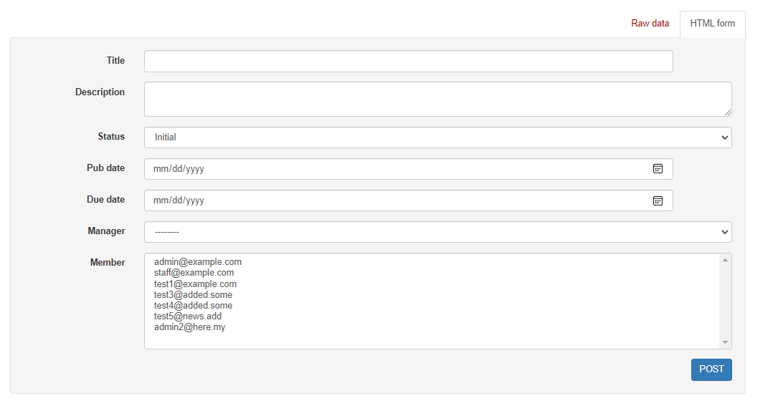
Now the webpage will have more forms for create, update, delete

Slide 14
User curl to do create and update
Create a new task todo
Partially update the task fields

